Slide 1
DIABETES PREDICTION OF PATIENTS
Doyel Maiti

Slide 2
INTRODUCTION
PSYLIQ provided data on diabetes patients in Excel sheet format. We analyzed this data using MySQL Workbench, focusing on factors such as age, smoking patterns, hypertension, and BMI, and delivered valuable insights to address the problem statements provided by PSYLIQ

Slide 3
PROJECT INSIGHTS

Slide 4
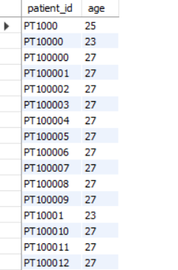
Retrieve the Patient_id and ages of all patients.
select
patient_id, TIMESTAMPDIFF(year, dob, now() ) -CASE WHEN (MONTH(dob) > MONTH(now())) OR (MONTH(dob) = MONTH(now()) AND DAY(dob) > DAY(now()))
THEN 1 ELSE 0 END as age
from
diabetes;
We used the TIMESTAMPDIFF function to calculate age from the date of birth based on the current date

Slide 5
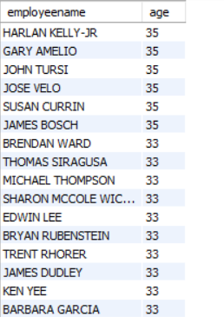
Select all female patients who are older than 30.
select
employeename , TIMESTAMPDIFF(year ,dob , now() ) -CASE WHEN (MONTH(dob) > MONTH(now())) OR (MONTH(dob) = MONTH(now()) AND DAY(dob) > DAY(now()))THEN 1 ELSE 0 END as age
from diabetes
where
(TIMESTAMPDIFF(year ,dob , now() ) -CASE
WHEN (MONTH(dob) > MONTH(now())) OR
(MONTH(dob) = MONTH(now()) AND DAY(dob) >
DAY(now()))
THEN 1 ELSE 0 END )>30
and gender ="female";

Slide 6

Calculate the average BMI of patients.
select
avg(bmi) as average_bmi
From
diabetes;
The average BMI of the patients is 27.24

Slide 7
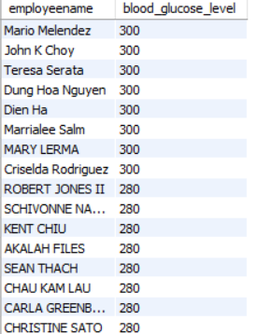
List patients in descending order of blood glucose levels.
Select
employeename , blood_glucose_level
from
diabetes
order by blood_glucose_level desc;
Blood glucose level among the employees varies from 300 to 80

Slide 8
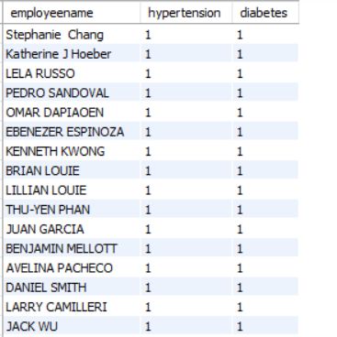
Find patients who have hypertension and diabetes.
select
employeename ,hypertension, diabetes from
diabetes
where hypertension !=0 and diabetes !=0

Slide 9

Determine the number of patients with heart disease.
select
count(patient_id) as Heart_disease_patients
from
diabetes
where heart_disease!=0
Total 3937 no of patients are there with heart disease

Slide 10
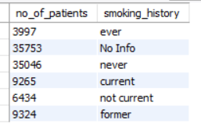
Group patients by smoking history and count how many smokers and non-smokers there are.
select
count(patient_id) as no_of_patients ,smoking_history from
diabetes
group by smoking_history;
In this query, patients are categorized based on their smoking patterns. It shows that there are 9,625 current smokers, while over 300,000 patients have never engaged in smoking.

Slide 11
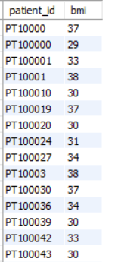
Retrieve the Patient_id of patients who have a BMI greater than the average BMI.
select patient_id,bmi
from diabetes
where bmi > (select avg(bmi) from diabetes);

Slide 12

Find the patient with the highest HbA1c level and the patient with the lowest HbA1clevel.
(select employeename, HbA1c_level from diabetes order by HbA1c_level desc limit 1)
union
(select employeename, HbA1c_level from diabetes order by HbA1c_level limit 1);
The query shows the two patients with highest and lowest HbA1clevel of 9 and 4 respectively.

Slide 13
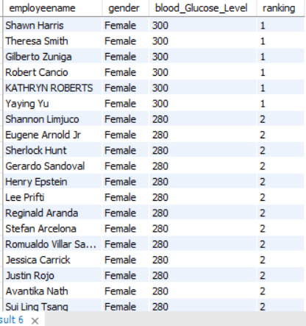
Rank patients by blood glucose level within each gender group.
SELECT employeename, gender, blood_Glucose_Level,
DENSE_RANK() OVER (PARTITION BY Gender ORDER BY Blood_Glucose_Level DESC) As ranking
FROM diabetes;
We used the window function to group the data by gender (male and female) and applied the DENSE_RANK function to rank the data in descending order within each group.

Slide 14
Update the smoking history of patients who are older than 40 to "Ex-smoker.
update diabetes
set smoking_history='ex-smoker'
where (TIMESTAMPDIFF(year,dob, now() ) -CASE WHEN (MONTH(dob) > MONTH(now())) OR (MONTH(dob) = MONTH(now()) AND DAY(dob) > DAY(now()))THEN 1 ELSE 0 END )> 40;
By executing this SQL query, the smoking history of all the the patients aged 40 years and above was updated as EX-smoker.

Slide 15
Insert a new patient into the database with sample data.
insert into diabetes
values("sana","PT100200",
"Female","1998-01-19",0,0,"never",27,6,140,0);

Slide 16
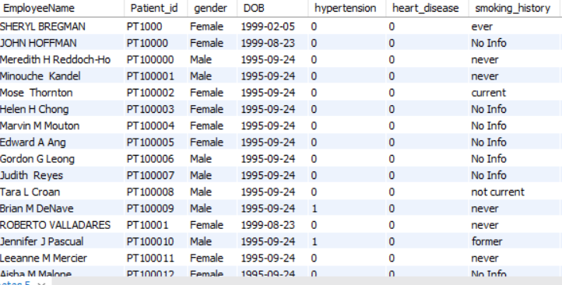
Delete all patients with heart disease from the database.
DELETE FROM Patients
WHERE Heart Disease=1;
This query has deleted the records of all the positive heart disease patients.

Slide 17
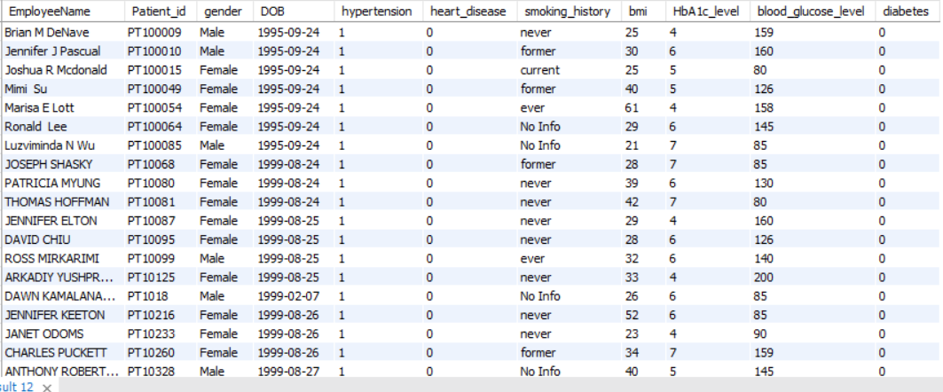
Find patients who have hypertension but not diabetes using the EXCEPT operator.
select * from diabetes where
hypertension=1 except
select * from diabetes
where diabetes>0;

Slide 18
Define a unique constraint on the "patient_id" column to ensure its values are unique.
ALTER TABLE diabetesADD CONSTRAINT unique_patient_id UNIQUE (Patient_id);
A unique constraint is used to ensure that all the values in a column (or a set of columns) are distinct from each other. This means that no two rows can have the same value in that column or combination of columns.

Slide 19
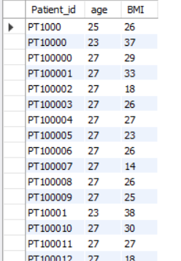
Create a view that displays the Patient_ids, ages, and BMI of patients.
CREATE VIEW Patient_BMI_View AS
SELECT
Patient_id,
TIMESTAMPDIFF(year,dob, now() ) -CASE
WHEN (MONTH(dob) > MONTH(now())) OR (MONTH(dob) = MONTH(now()) AND DAY(dob) > DAY(now()))
THEN 1 ELSE 0 END as age ,
BMI
FROM diabetes ;
select*from Patient_BMI_View;
A view is a virtual table. It does not store data physically. Instead, it retrieves data from one or more underlying tables whenever it is queried. It is also used to restrict the access of users to the main table.

Slide 20
Suggest improvements in the database schema to reduce data redundancy and improve data integrity.
Different ways to reduce data redundancy and improve data integrity are as follows---
Use of Foreign Keys : Foreign key ensures that relationships between tables are consistent and prevents stray records .This way it helps to improve data integrity within the table.
Use of Constraints: Appropriate constraints like UNIQUE, NOT NULL, and CHECK etc. helps to prevent the entry of duplicate, null, or invalid data.
Normalization: Normalization is a database design process used to organize data to reduce redundancy and improve data integrity. The process involves dividing a database into smaller, related tables and defining relationships between them using 1F,2F and 3F formulas.
Entity-Relationship Modelling: Reviewing the Entity-Relationship (ER) model helps to identify and correct any redundant relationships or entities . It also ensures each entity is correctly represented with appropriate attributes.

Slide 21
Explain how you can optimize the performance of SQL queries on this dataset.
Some ways to improve efficiency and optimize the performance of SQL queries---
Indexing: Indexing is a crucial technique to enhance the performance in large tables. Indexes significantly reduce the time it takes to execute queries by allowing the database to quickly access the data without scanning the entire table.
Limiting returned data: While working with large datasets, limiting the returned data can improve the performance of queries. Window functions can group, aggregate, and limit data from large datasets. For example, a table may have a million rows, and to show only 10 records we can use LIMIT or windows function(row_number).
Avoiding subqueries: When subqueries are used in WHERE or HAVING clauses, they can slow down the performance of the query. This is because they can return large numbers of rows, making them difficult to execute. To avoid the situation JOIN clauses can be used.

Slide 22
THANKS!
Do you have any questions?
doyel.maiti1901@gmail.com

